Slide 1

ample.
enough for everyone.

Slide 2







meet tony.
Small business owner
Business Background
Fluctuations in demand
Excess edible food
Rejected prepared foods
Donation Experience
Afraid of liability
Too busy

Slide 3



the problems.
Information Barrier
Logistical Hassle
Food Waste
Federal and State-level protection laws
Enhanced federal
tax incentives
Too busy managing business and day-to-day operations
Another operational
burden
Adverse natural resource and
environmental impacts
Missed social and economic opportunities

Slide 4


ample.
Who We Are
A one-stop food donation platform that zeroes out food waste by leveraging tax incentives for food businesses and amplifying opportunities for non-profits.
Our Mission
To reimagine community food sustainability and simplify the food donation process.

Slide 5



unique values.
Marketplace Platform
“Pay” As You Go
Direct Access
Amplifying donation sources and network
Removes logistical burden for businesses
Commission-based model
Businesses pay 5% of tax savings per donation
Certified businesses and registered non-profits
Foster relationships in local communities

Slide 6
our technology.
Mobile
Insightful
Smartphones are highly available to our customers
Waste statistics are valuable to businesses and non-profits
Cross-platform
Easy to Use
Lowered costs and decreased development time
Optimized for older, less tech-savvy individuals

Slide 7
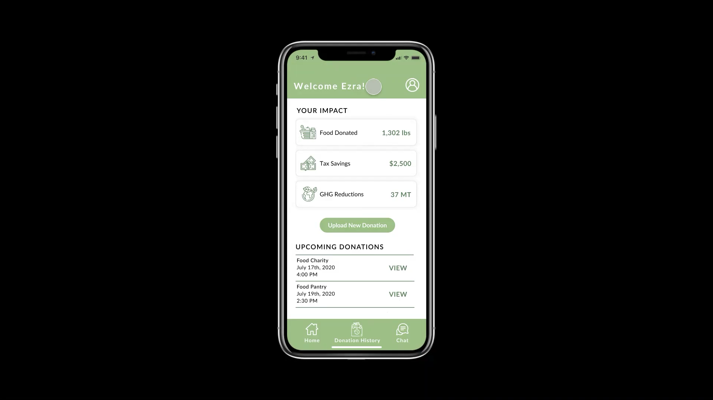
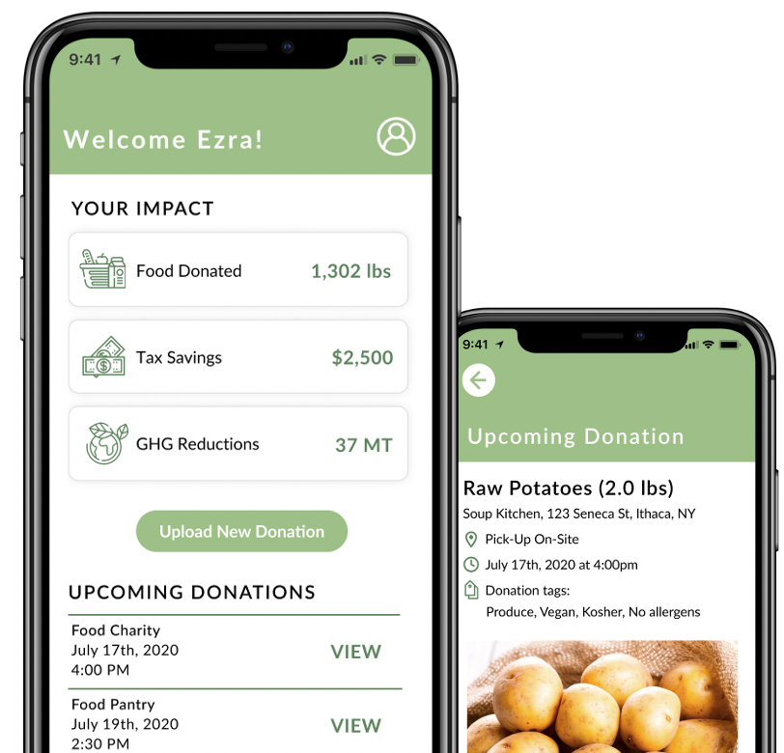
product demo.
Embedded Demo Video Here

Slide 8
market sizing.
$ 38.2 B
Total Addressable Market
Based on 2017 USDA research
$ 20.4 B
Serviceable Addressable Market
Based on 2018 NPD Group research
$ 4.9 B
Serviceable Obtainable Market
Based on customer discovery

Slide 9


competitor analysis.
 | ample. | Copia | Goodr | Replate
Tax Savings Service
Marketplace Platform
Pay-as-you-go Model
Geographic Reach
User-Tailored Design

Slide 10






customer acquisition strategies.
Trade Journal Ads
Advertise in food industry journals and magazines
Door-to-door Sales
Demo the product in front of our target customers
Industry Conferences
Present the ample solution and extend our reach
Consideration
Direct Mail Campaign
Target business owners and spread the word
Referrals
Promote discounts for successful referrals

Slide 11



business model.
we take a 5% commission on each transaction
$200
12,750
$2.55
DOLLARS
CUSTOMERS
MILLION DOLLARS
Average Commission
per customer
per year
Restaurants
projected
by 2025
Revenue
projected
by 2025

Slide 12
financial projections.
Projections for 2025
Revenue
$2.55 M
Customers
12,750
Gross Profit
≈ $2.549 M
EBIT
≈ 1.95 M

Slide 13




our team.
Shruti Agarwal
Maggie Liu
Emily Lin
Jackson Booth
Cornell University
Applied Economics ‘21
Cornell University
Policy Analysis ‘20
Cornell University
Policy Analysis ‘20
Cornell University
Computer Science ‘21

Slide 14
questions?

Slide 15
appendix: introduction.
https://www.chlpi.org/wp-content/uploads/2013/12/50-State-Food-Regs_March-2018_V2.pdf
https://www.nrdc.org/sites/default/files/wasted-2017-report.pdf
https://digitalrepository.unm.edu/cgi/viewcontent.cgi?article=3993&context=nrj
https://www.usda.gov/foodlossandwaste
https://www.fda.gov/food/consumers/food-loss-and-waste

Slide 16
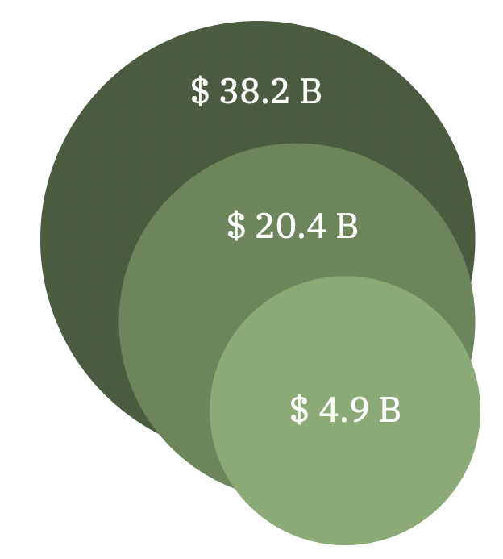
appendix: market sizing.
U.S Restaurant Food Waste ¹
25,000 lbs
Total U.S. Food Waste ¹
142,500 lbs
Yearly Cost of U.S. Food Waste ²
$ 218 Billion
TAM
$38.2 Billion
TAM
$38.2 Billion
# Independent U.S. restaurants ³
346,105
# Total U.S. Restaurants ³
647,288
SAM
$20.4 Billion
SAM
$20.4 Billion
Packaging Factor
.66
Transportation Factor
.36
SOM
$4.9 Billion
References
¹“Food Waste FAQs.” USDA, USDA Economic Research Service, (n.d.).
²“Food Waste Is a Massive Problem-Here's Why.” FoodPrint, 15 Apr. 2020.
³“Number of Restaurants in the U.S.” NPD, The NPD Group, 2018.

Slide 17
appendix: financials.
Financial Projections
 | 2021 | 2022 | 2023 | 2024 | 2025
Commission per Food Donor | $200 | $200 | $200 | $200 | $200
Customers | 100 | 550 | 2,500 | 6,000 | 12,750
Customer Growth % |  | 450.0% | 354.5% | 140.0% | 112.5%
Revenue | $20,000 | $110,000 | $500,000 | $1,200,000 | $2,550,000
Cost of Goods Sold | $250 | $550 | $550 | $550 | $550
Gross Profit | $19,750 | $109,450 | $499,450 | $1,199,450 | $2,549,450
Gross Profit Growth % |  | 454.2% | 356.3% | 140.2% | 112.6%
Expenses | $226,450 | $238,870 | $505,802 | $533,708 | $600,196
Salaries | $220,000 | $231,000 | $492,550 | $504,678 | $517,411
Marketing | $6,000 | $7,800 | $13,182 | $28,961 | $82,715
Incorporation Fee | 450 | 70 | 70 | 70 | 70
EBIT | ($206,700) | ($129,420) | ($6,352) | $665,742 | $1,949,254
EBIT Margin % | 0.0% | 0.0% | 0.0% | 55.5% | 76.4%
Yearly Restaurant Food Waste
25,000 lbs
Cost of Food Waste
$0.64/lb
Edible Food
50%
Food Value in Tax Deduction
50%
Commission per Tax Deduction
5%
Yearly Commission Per Food Donor
$200

